Slide 1
“Data” joBs in the US Market
Han Yang, Will Copeland, Shilpa Muralidhar

Slide 2
Shilpa
Why are we presenting on ”data jobs”?

Slide 3
Questions
Each question corresponds to a graph(s). Fill this slide in once all graphs are added

Slide 4
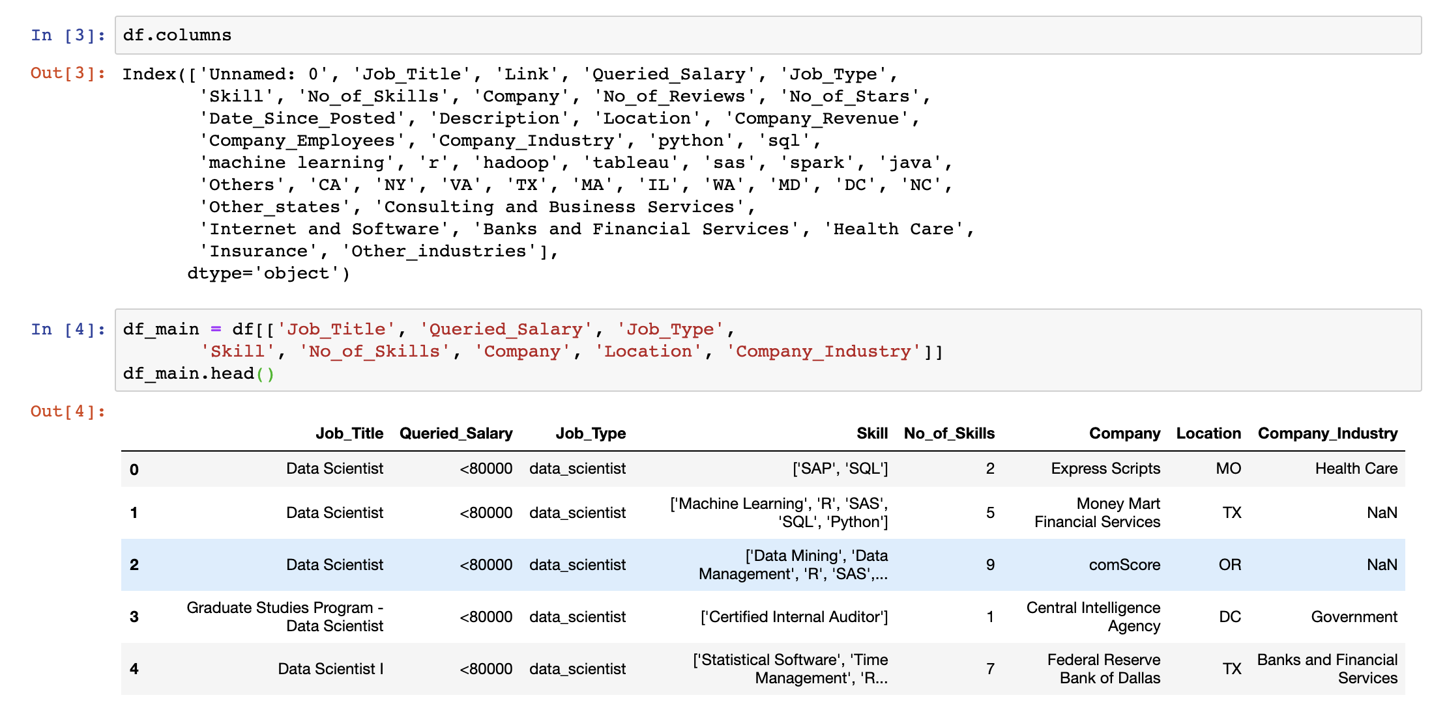
Flowchart
Process of data cleaning
Got it from Kaggle
It’s 9-months old
What does it look like? Columns etc?
Pre-cleaning

Slide 5
Shilpa – 2-3 slides here
What is the distribution of data jobs by state?

Slide 6
Han – 2-3 Slides
What is the distribution of skills?

Slide 7
Job type vs skills
Job type
Data Analyst,
Skills of interest
Data cleaning
python pandas
Data Analysis (Chi-square test)
Observed=
expected =

Slide 8
Cont’d

Slide 9
Skills vs salary

Slide 10
Cont’d
upward
stable

Slide 11
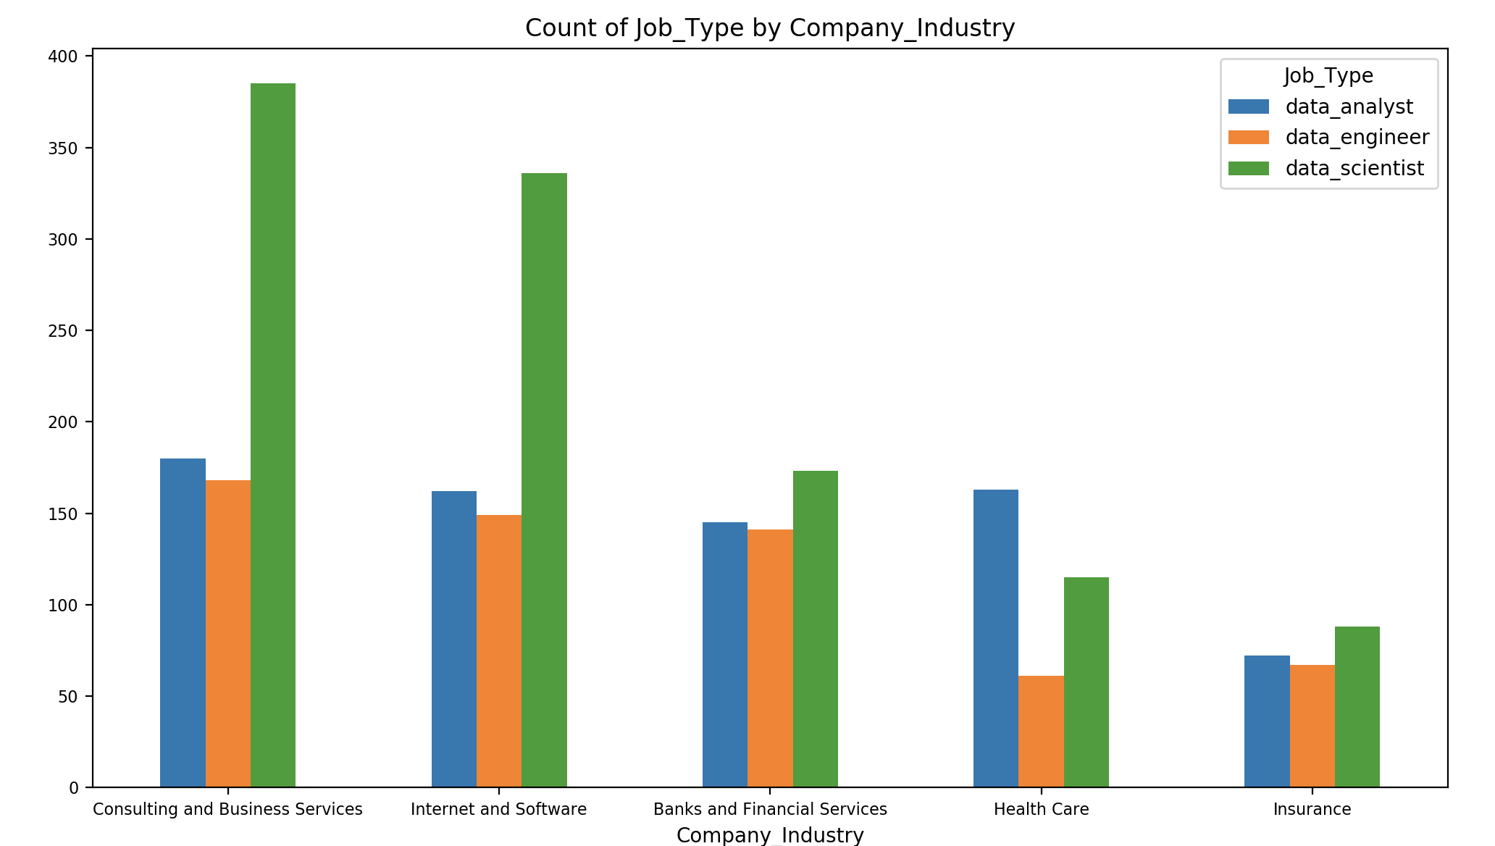
Jobs Counts in the top Industries
What is the distribution of “data jobs” in different industries?
Graph of total job counts in each industry

Slide 12
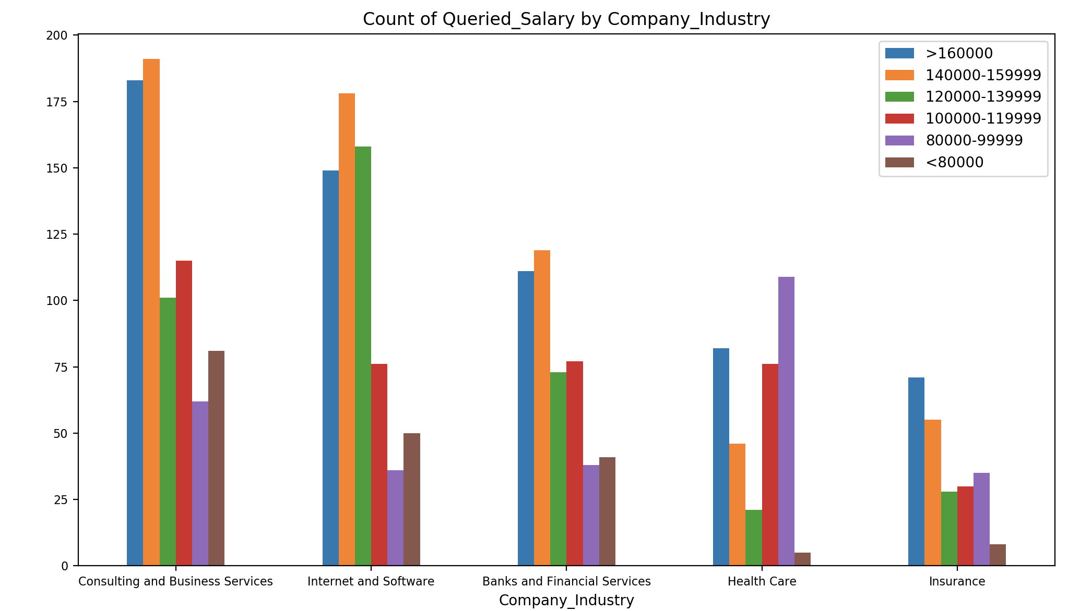
Salaries in the top Industries
What is the distribution of “data jobs” in different industries?
Graph of total job counts in each industry

Slide 13
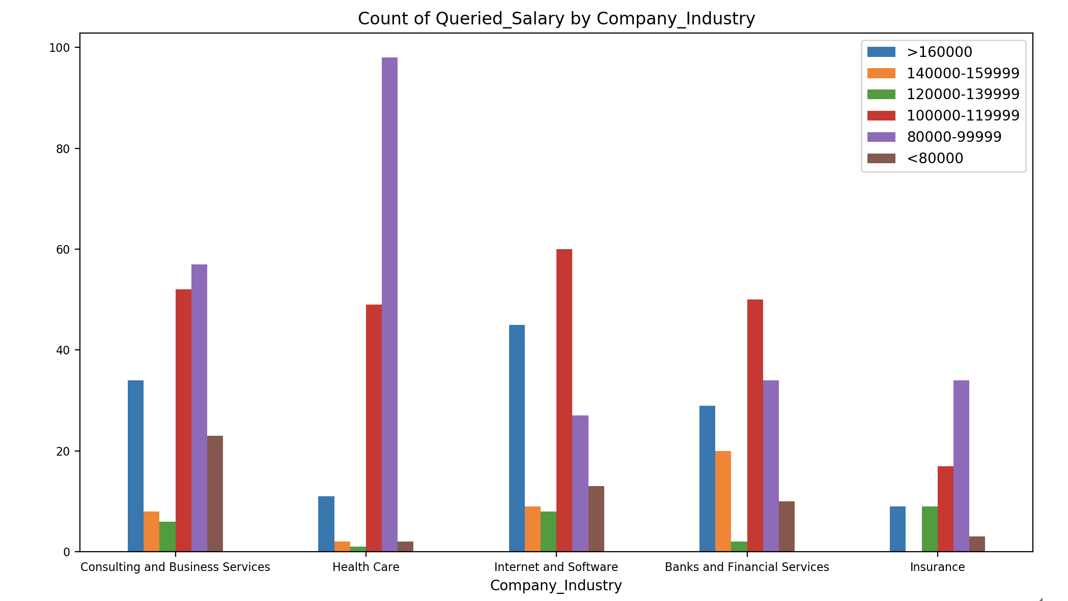
Data Analyst Salaries in the Top Industries
What is the distribution of “data jobs” in different industries?
Graph of total job counts in each industry

Slide 14
Major conclusions – we each reiterate from our slides
States
Skills
Industries

Slide 15
The End
Questions?

